Slide 1

SYSTEM DESIGN : FOODIE APP
Sagar Kadam Sr. Software Engineer

Slide 2
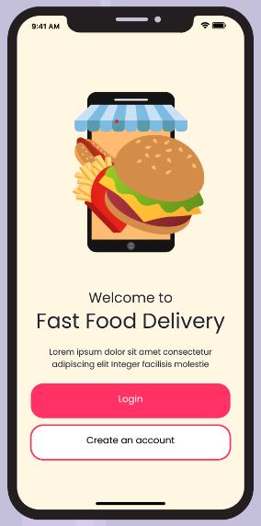
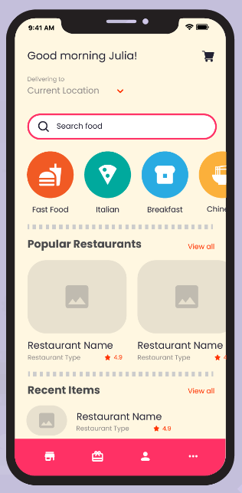
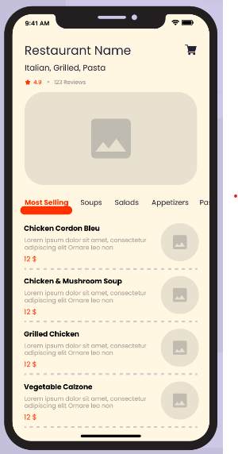
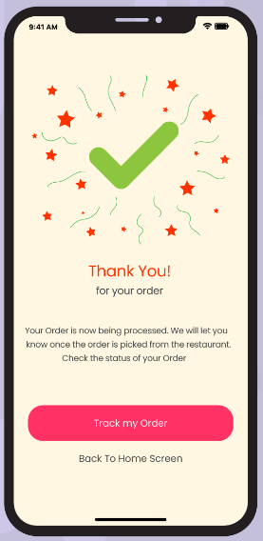
Let’s Imagining Application Flow

Slide 3
Functional Requirements
1. Restaurant Registration & Management
Restaurants can register with their profile, menu, pricing, and inventory.
Restaurants can update their menu items, prices, and stock availability.
Restaurants can accept or decline orders based on availability.
2. User Search & Order
Users can search for restaurants by name, dish, or cuisine.
Users can place restaurant orders
Users can view and manage their order history.
3. Payment Integration
Users can view transaction details and order payment status
4. Real-Time Delivery Tracking
Track delivery partners' real-time location on a map.
Notify users of estimated delivery time and status updates.
5. Notification Service
Push notifications for order updates, payment confirmation, and delivery tracking

Slide 4
Non Functional Requirements
High Availability
Low Latency
Scalable
Consistency
Durable

Slide 5
Estimation And Constraints
Assumptions:
10 million active users monthly.
Average of 5 orders per user per month.
Average of 3 items per order.
Average search traffic: 50 million searches per month.
10,000 restaurants on the platform.
Storage Estimation:
Assuming each order requires about 1KB and each restaurant/menu around 50KB.
Order data: 1.5 million orders/day×1 KB×30 days=≈50 GB/ month
Total storage (including logs, history): ~1TB/month.
Write-heavy operations: For real-time inventory updates and order processing.
Calculations
Orders per day: 10M×5/30 = ~1.5 million orders per day
Items per day: 1.5 million×3 = ~5 million items per day
Read-heavy operations: High read requirements for search, menu lookup, and location tracking.

Slide 6

Databases Selection
We don't necessarily need to store everything in a single database
Write Heavy
Read Heavy
RDBMS(MySQL): : For structured, transactional data (e.g., users, orders, payments).
NoSQL (MongoDB): For flexible, document-based data (e.g., menu items, inventory).
In-Memory Cache(Redis): : For frequently accessed data, such as popular searches and user sessions.

Slide 7
Schema Design
Users Table:
user_id, name, phone , email, address , password_hash, created_at
Restaurants Table
restaurant_id, name, location, rating, created_at
Menus Table
menu_id, restaurant_id, dish_name, price, availability, description, created_at
Orders Table
order_id, user_id, restaurant_id ,total_amount, status, created_at
Order Details Table
order_detail_id, order_id, menu_id, quantity
Payments
payment_id, order_id, amount, status, created_at

Slide 8
API Endpoints
1.User Registration
POST /api/users/register
Request { "name": "John", "email": "john@example.com", "password": "password123" }
Response 201 Created
5.Payment Processing
POST /api/payments
Request { "order_id": 1, "amount": 25.5 }
Response 200 OK
2.Restaurant Registration
POST /api/restaurants/register
Request { "name": "Pizza Place", "cuisine": "Italian", "address": "123 Street", "contact": "1234567890" } Response 201 Created
6.Track Delivery
GET /api/delivery/{order_id}/track
Response { "location": {"lat": 40.7128, "lng": -74.0060}, "eta": "15 mins" }}
3.Menu Update
PUT /api/restaurants/{restaurant_id}/menu
Request { "items": [{ "name": "Pasta", "price": 12.5 }] }
Response 200 OK
4.Place Order
POST /api/orders
Request { "user_id": 1, "items": [{"restaurant_id": 2, "menu_item_id": 3, "quantity": 1}] }
Response 201 Created

Slide 9
Core Algorithms for Key Functionalities
Recommendation Algorithm
Route Optimization for Delivery Partners
Inventory Management

Slide 10



Architecture
Location Service
Payment Service
Delivery Service
Restaurant Service
API Gateway
Order Service
Notification Service
Search & Recommendation Service
Driver DB MySQL Cluster
Master
Slave1
Slave2
User Service
Redis Cluster

Slide 11
Search Service
Data Sync
API Gateway
Main Database
Search Service
Elastic Search
User

Slide 12
Delivery System
-Ratings of Delivery Partner -Fairness -No of deliveries per day
User
Where is the rider? API Call
Table 1:Rider_Id, Location,
Table 2: Ratings
Delivery Manager
Restaurents
Rider Manager
Notification Service
Rider

Slide 13

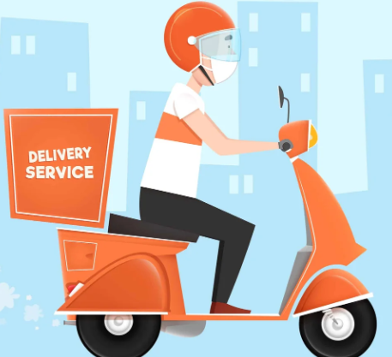

Location Service (ETA)
Redis Cluster
K
A
F
K
A
L
B
D1
Location Service
Web Socket Handler
Cassandra Cluster
D2
D3
MAP Service
Other Services

Slide 14
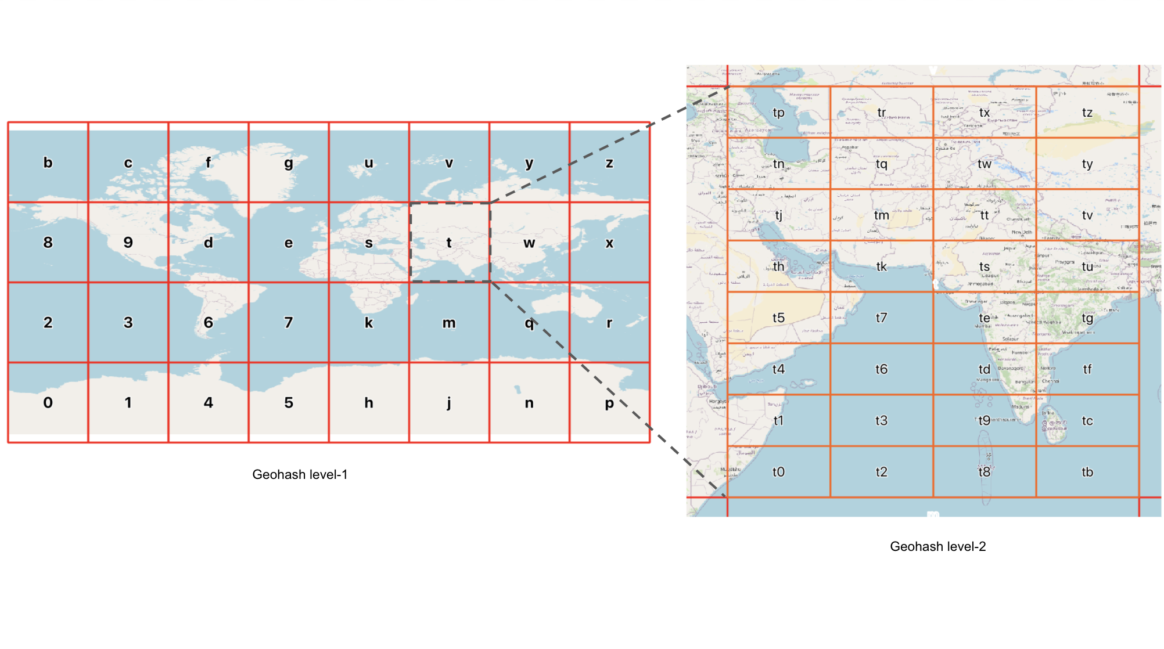

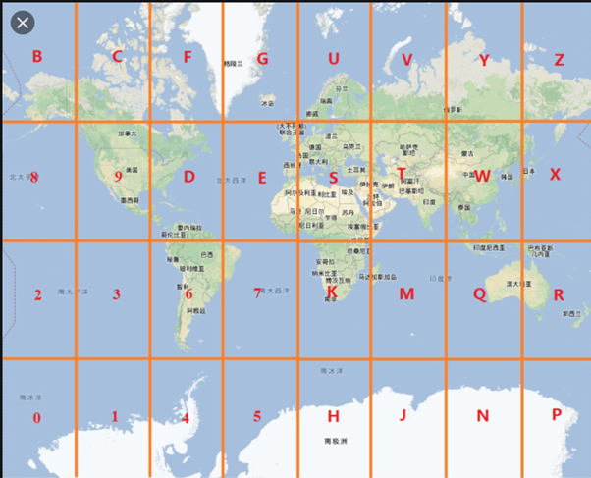
Role of S2 Library

Slide 15
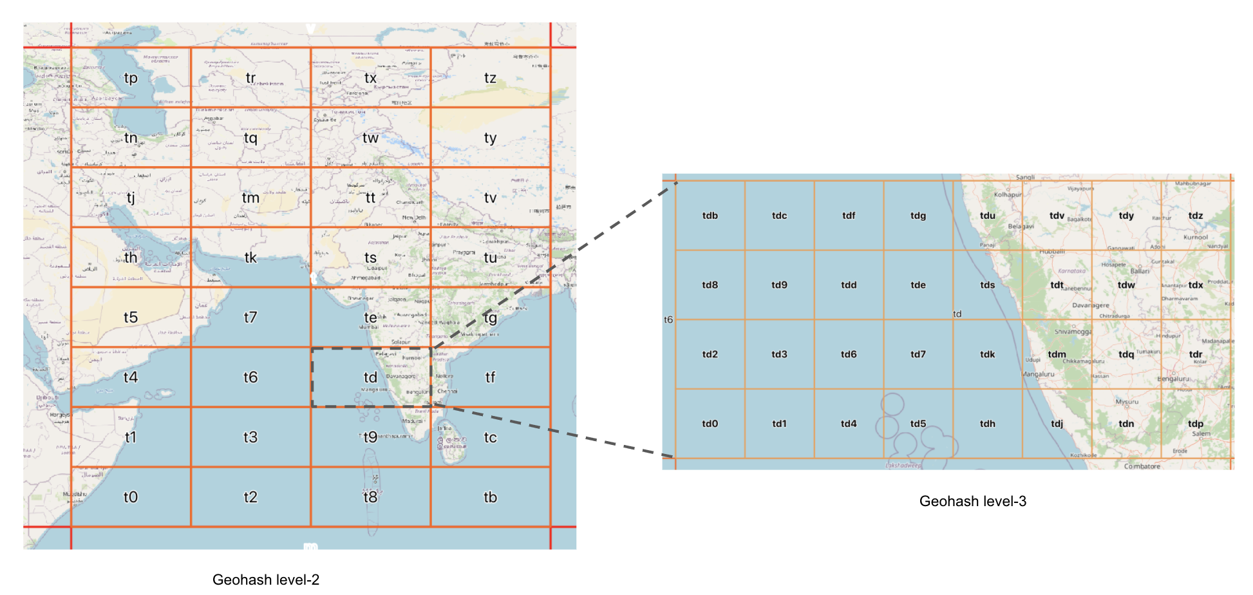
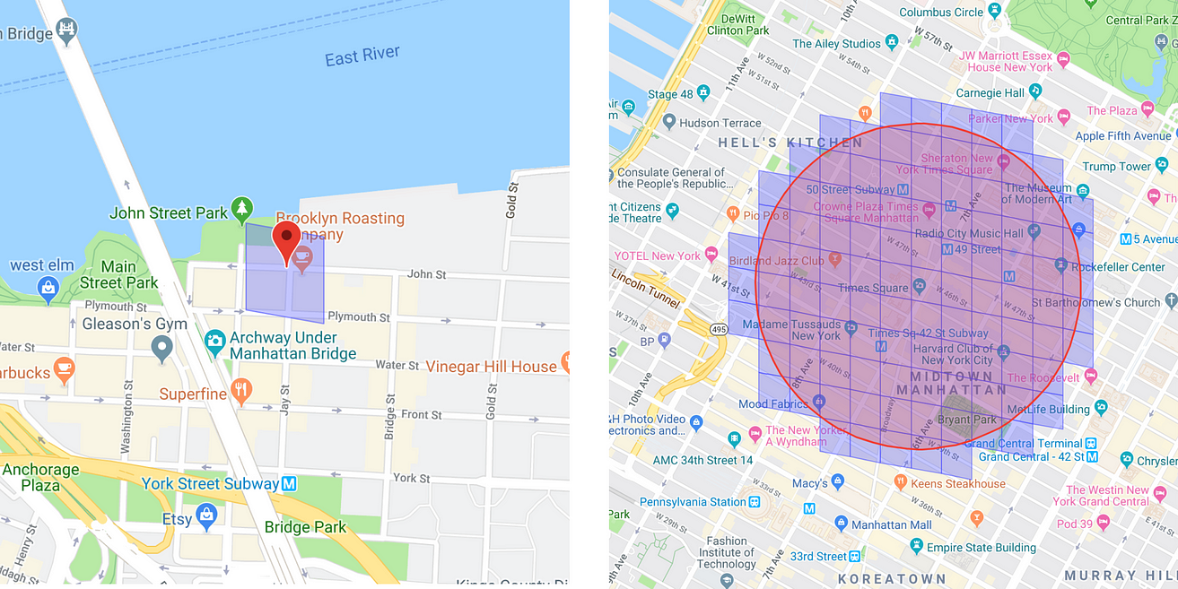

Slide 16
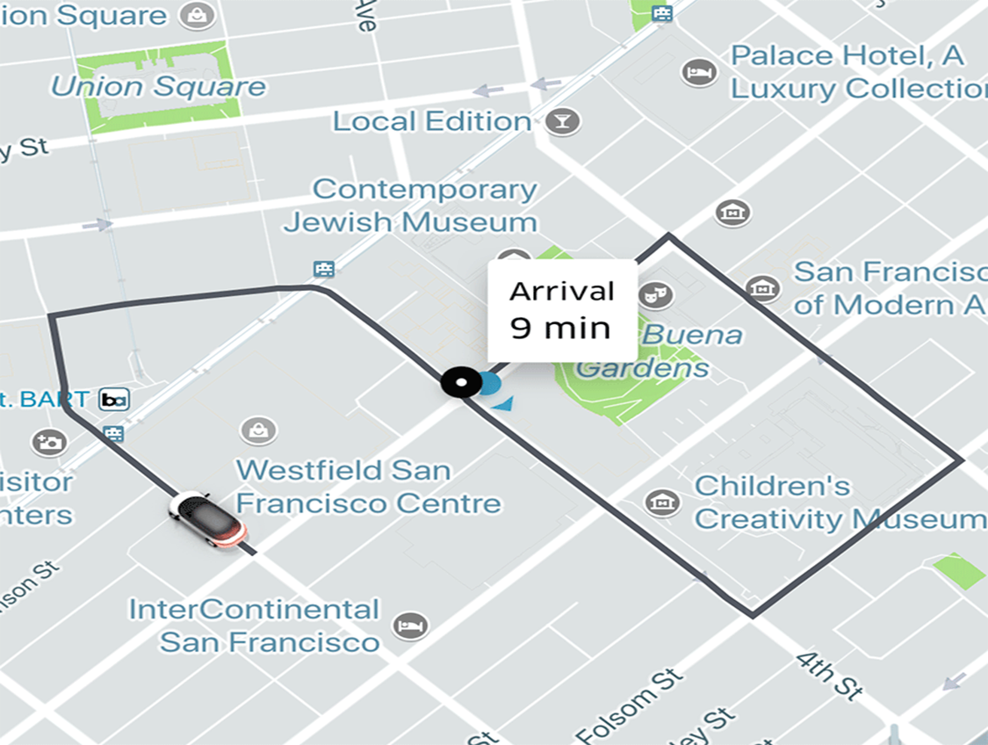
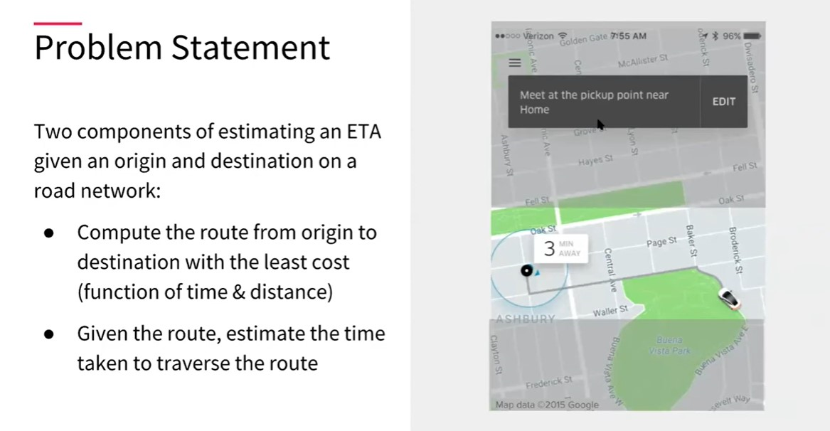
Predicting ETAs

Slide 17
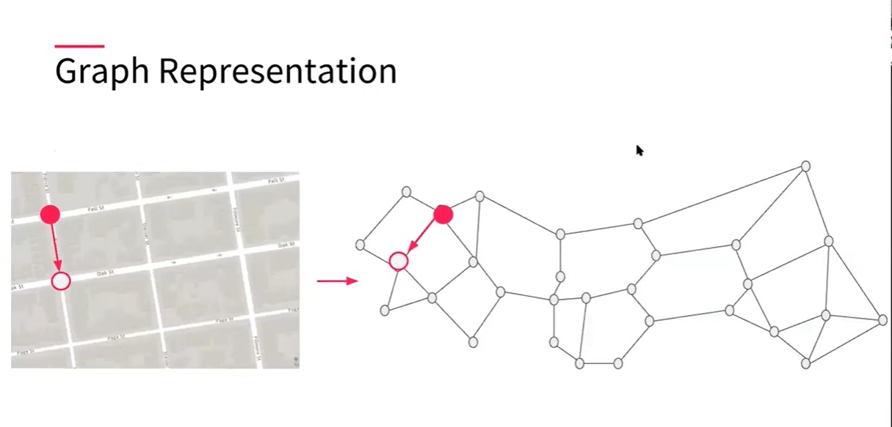
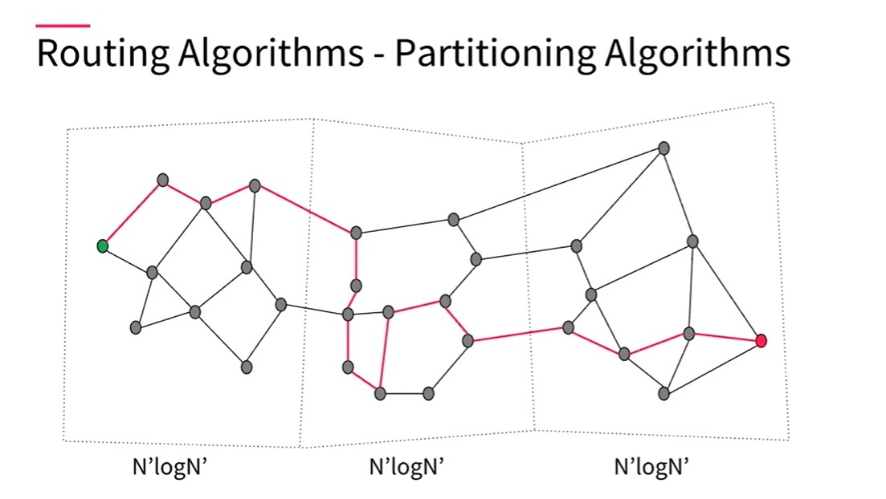

Slide 18
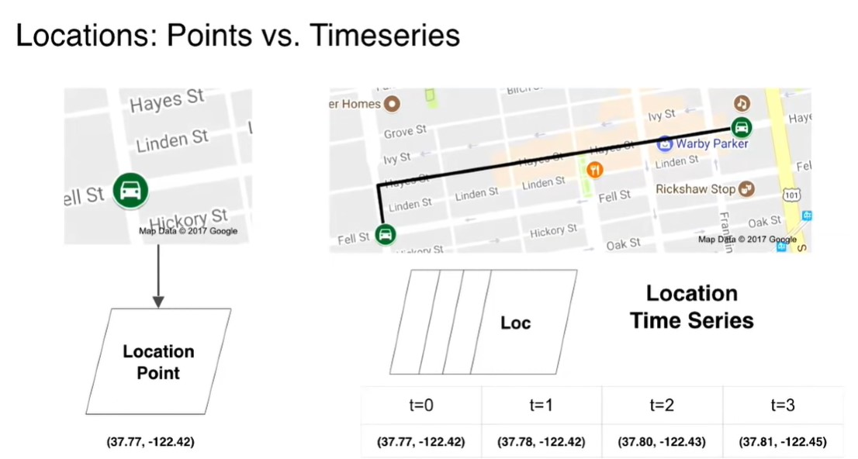
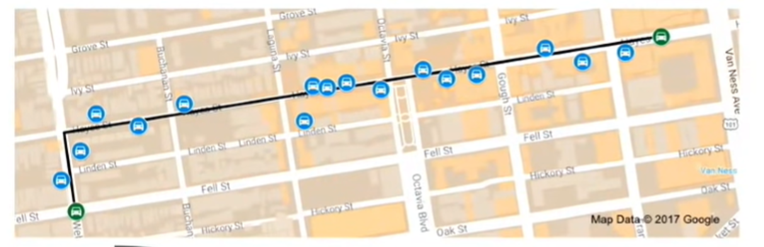
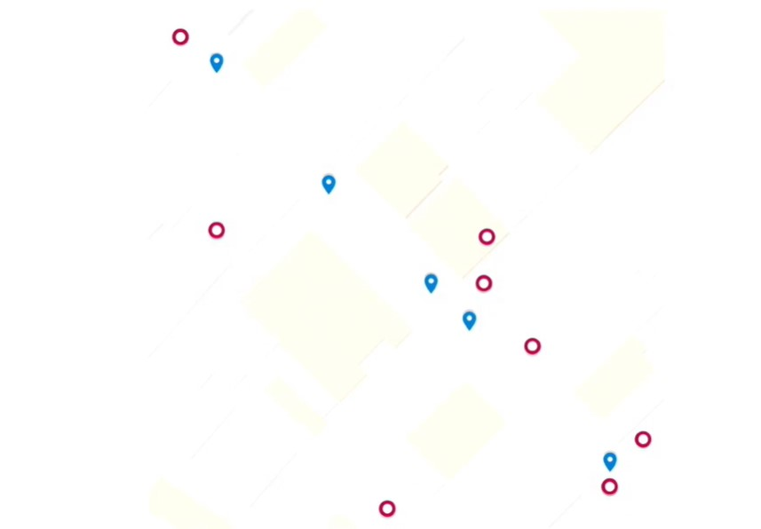
How Map Navigation Works?

Slide 19
Future Scope
AI-Driven Personalization: Enhance recommendation engine with AI to recommend dishes based on time of day, location, and weather.
Dynamic Pricing: Enable restaurants to set dynamic pricing based on demand and time of day.
Enhanced Analytics: Provide restaurants with detailed insights on customer behavior and popular items.
Expansion into Other Services: Integrate grocery delivery, catering services, or event-based food ordering.

Slide 20
PAUSE
The evolution of system design is an exciting journey with limitless potential

